Slide 1
CAAFI 2014
General Meeting
& Expo
Airline Engagement & Partnerships: Part 2
Moderated by: Bruno Miller, CAAFI Business Team Co-Lead
Chris Cawein, Manager, Global Jet Fuel & Energy Sourcing, Fed Ex
Jay Long, Dir. Fuel Administration, Alaska Airlines
Dirk Kronemeijer, CEO, SkyNRG
Robert Do, CEO, Solena
Leigh Hudson, Environmental Manager - Carbon Management/Biofuels, British Airways
Produced by

Slide 2
PROJECT DEVELOPMENT
FINANCING
Project Developer, Owner, Operator & Technology Provider
TIER ONE ECA
(Confidential)
TECHNOLOGY
LIQUID OFFTAKE
SPE for London Project
Engineering
POTENTIAL
FEEDSTOCK SUPPLY
Jet Offtake (contracted)
TIER ONE ECA
(Confidential)
Diesel & Naphtha Offtake (MOU)

Slide 3
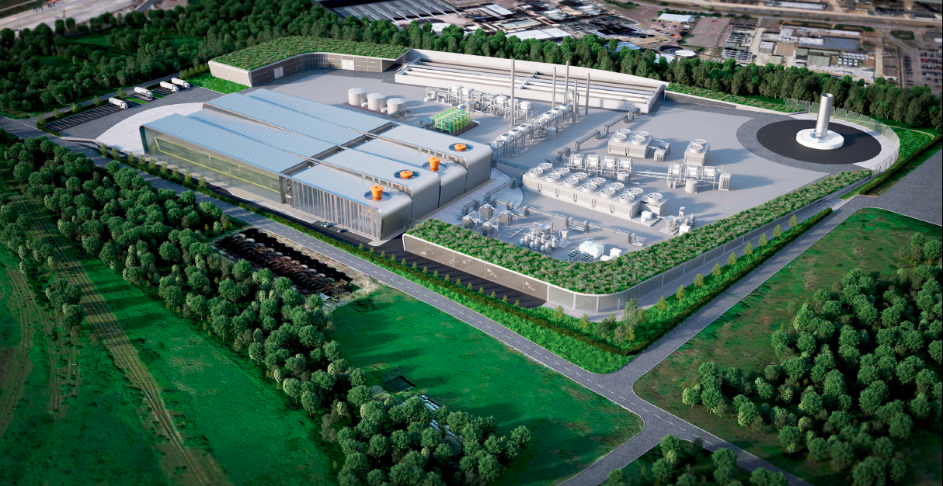

Slide 4
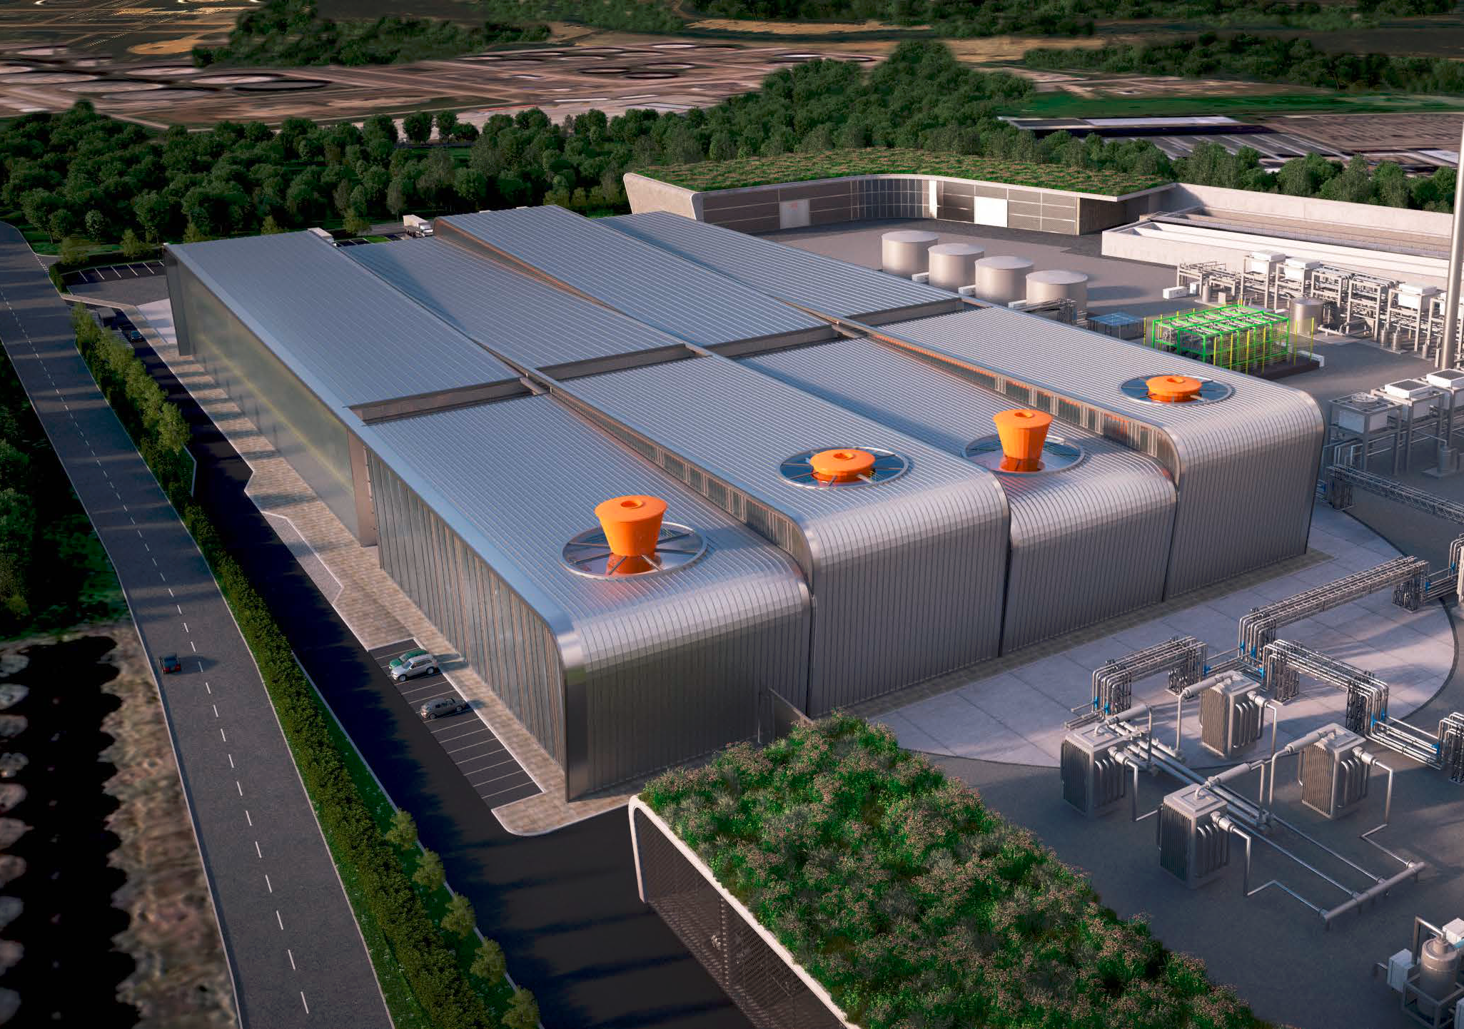

Slide 5
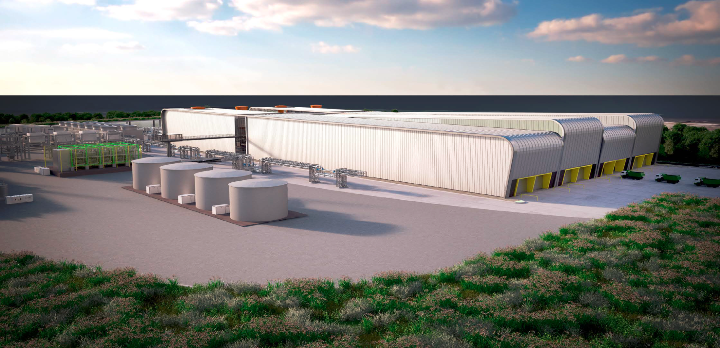

Slide 7
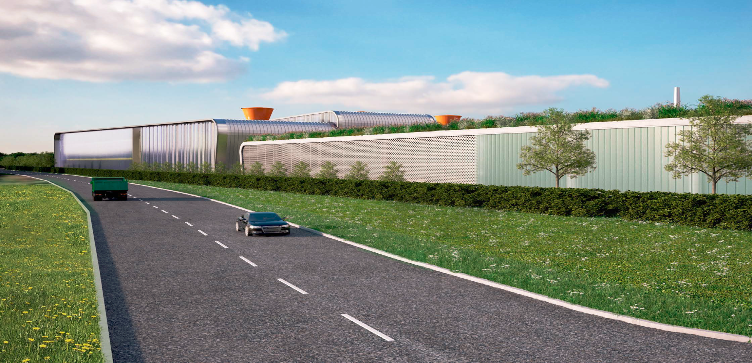

Slide 8
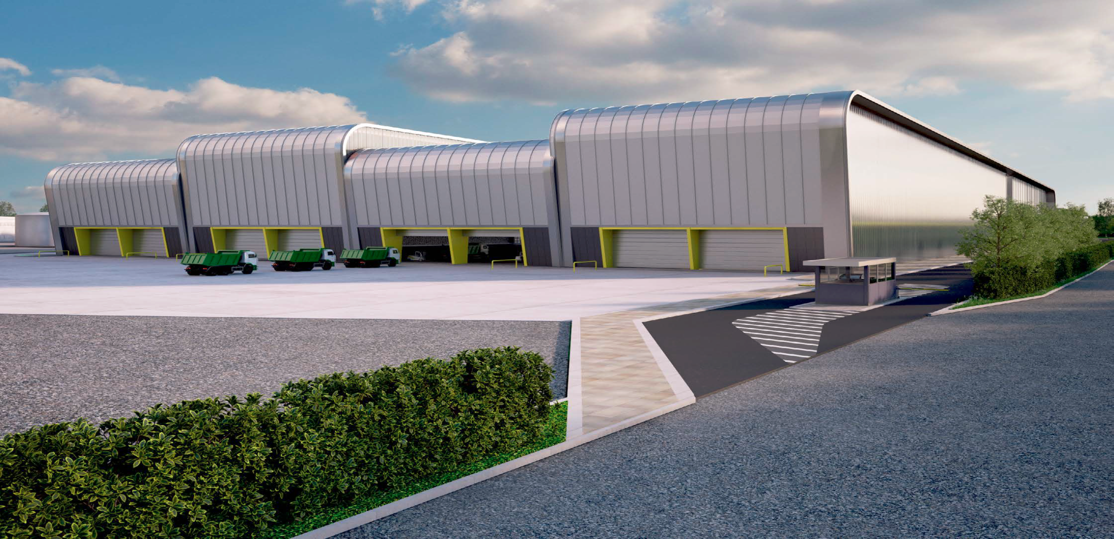

Slide 9
